Slide 1
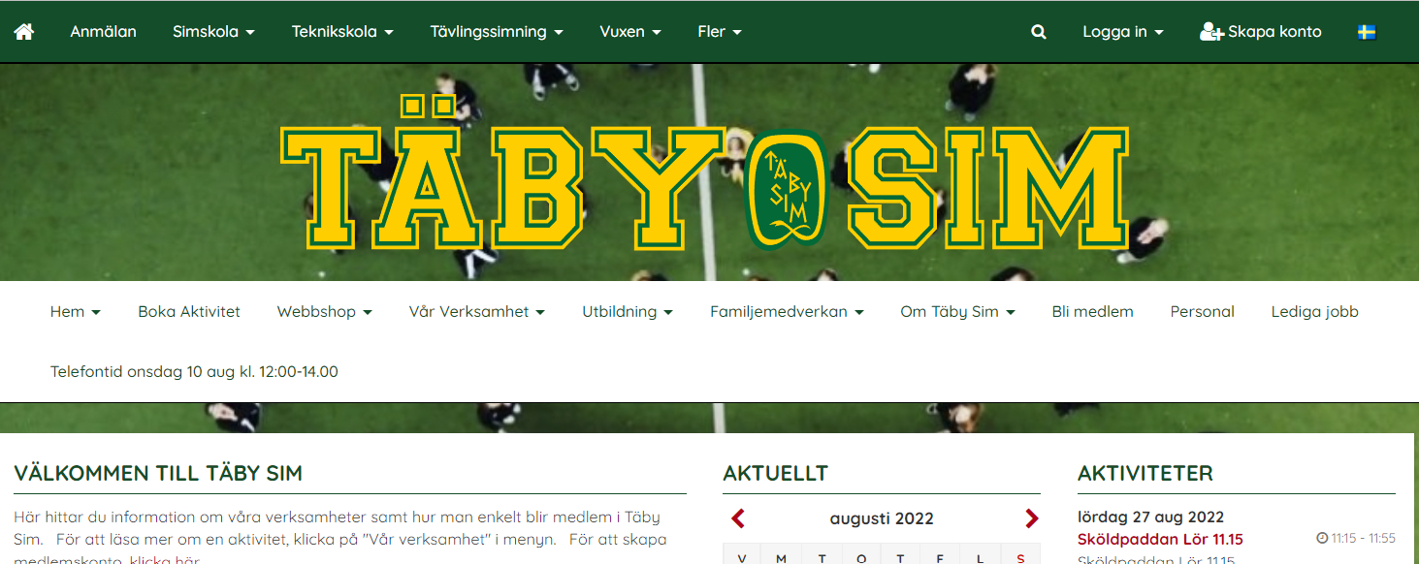
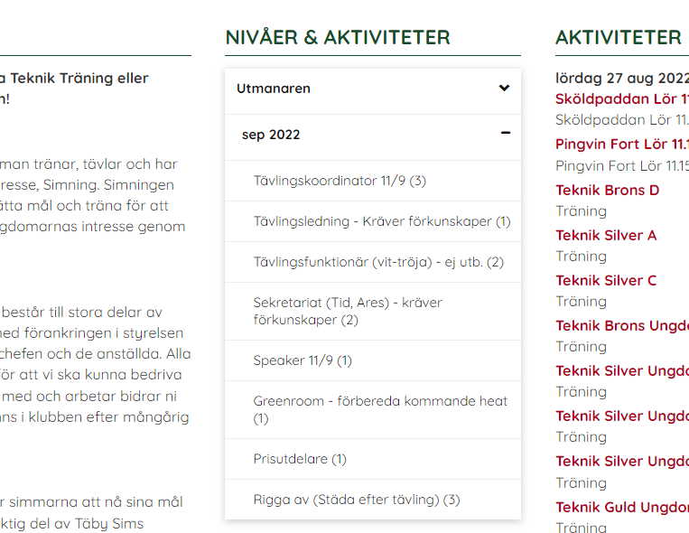
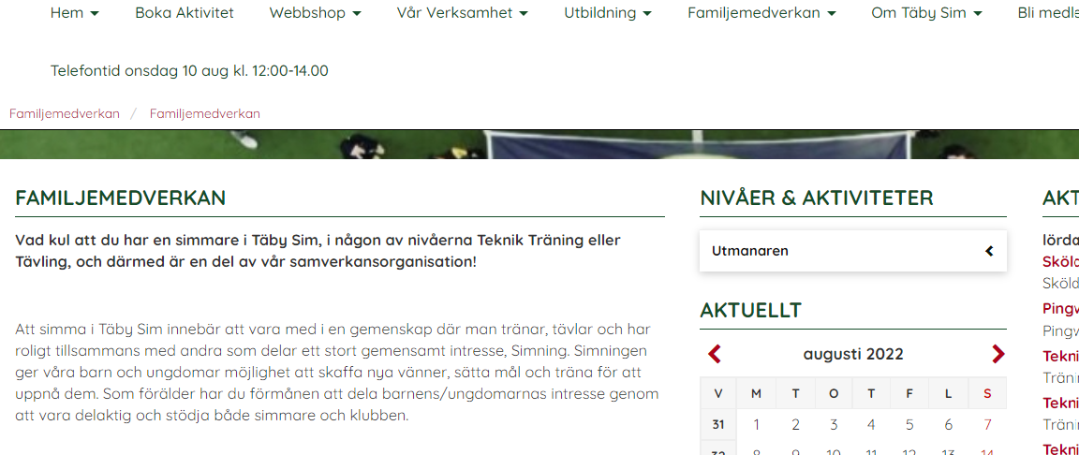
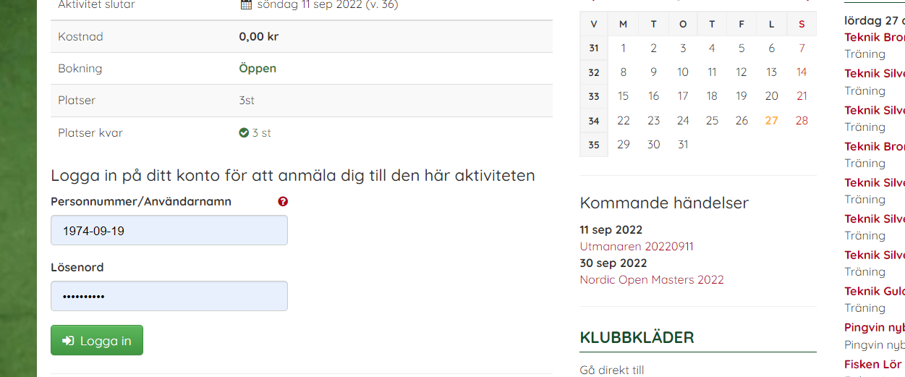
Instruction: How to assign to ”familjemedverkan”
Go to web page: www.tabysim.se
In the lower menu, go to “Familjemedverkan” and then “Familjemedverkan”, klick
You will now se the occation we need support with. For example, “Utmanaren” as in the picture below. Klick on ”Utmanaren”
After the first klick, you will see month, with activities
Klick on month to expand tasks. The number between bars (x) indicate how many more persons we need for the particular task.
Klick on the task you would like to assign to.
Read description on the left, scroll down and log in, to assign.

